Slide 1
A Combined Eulerian-Lagrangian Data Representation for Large-Scale applications.
Authors - Franz Sauer, Jinrong Xie, Kwan- Liu.
-Kottur Abhishek Anand

Slide 2
Contributions
A new indexing-based approach for enhanced analysis and visualisation.
An analytical tool for fast disk queries and out-of-core operations.
Extend this to efficiently sample multi-resolution subsets of large-scale data.

Slide 3
Eulerian and Lagrangian Representation
Eulerian representation: Study of particles at a specific geometric location and time.
Lagrangian Representation: Study of movement of set of parcels throughout the domain.

Slide 4
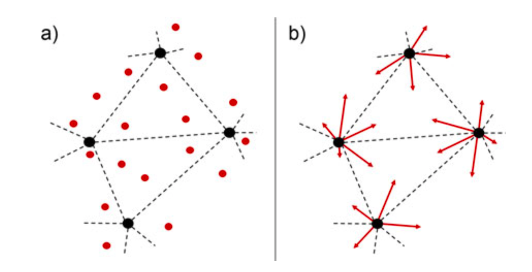
a) Unstructured Eulerian grid and Lagrangian particles. b) Particles as vectors from its nearest Eulerian grid point
Associate each particle to a unique grid location based on euclidean separation distance.

Slide 5
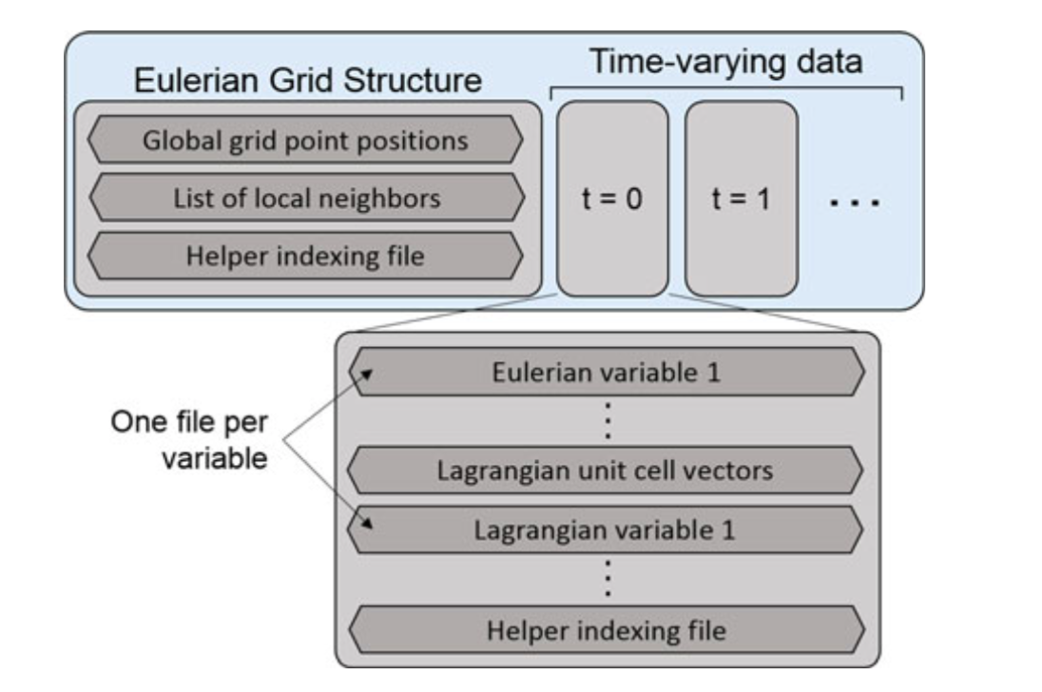
Files structure on disk
Fig. A representation of the joint data structure as files on disk.

Slide 6
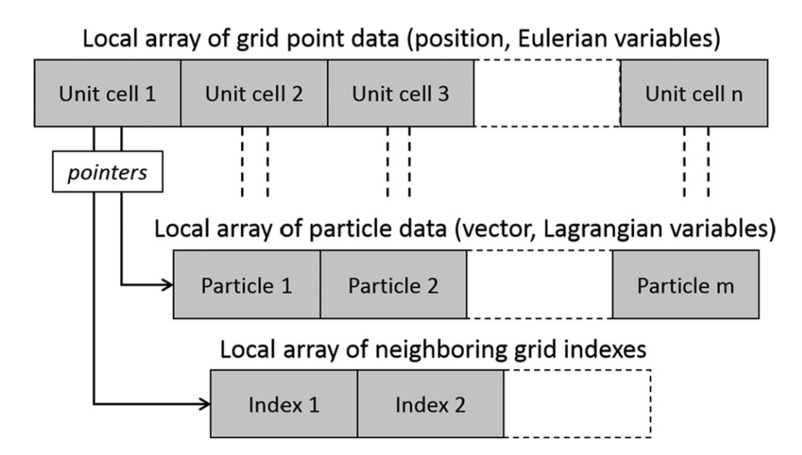
For a single time step
Fig. A representation of joint data structure once in memory

Slide 7
Files structure on disk
All the particle data associated with a unit cell are grouped in contiguous chunks in the disk.
Helpers files is used as size of unit cells is not constant.
Each eulerian variable can be saved without a helper files.
Lagrangian particle data of a unit cell is grouped together in the order of grid point index with helper files.
Additional storage for helper files is 2n(t_{p+1) integer values.}

Slide 8
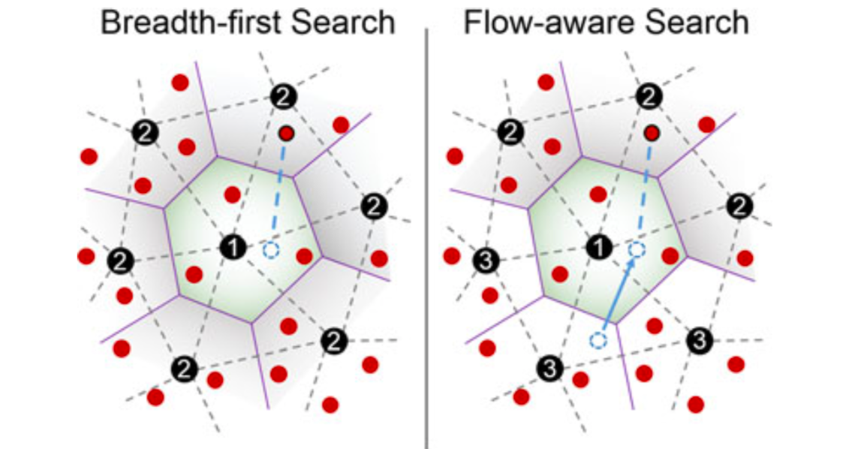
Constructing Trajectories
Fig. Searching the particle position with location in the previous time-step.

Slide 9
Multi-Resolution Sampling
With the joint data structure, we can easily select a percentage of particles in each unit cell.
On the other hand we can evenly sample the data with same number of particles, which loads the particles where eulerian grid density is higher.

Slide 10
Case-Studies & Results

Slide 11
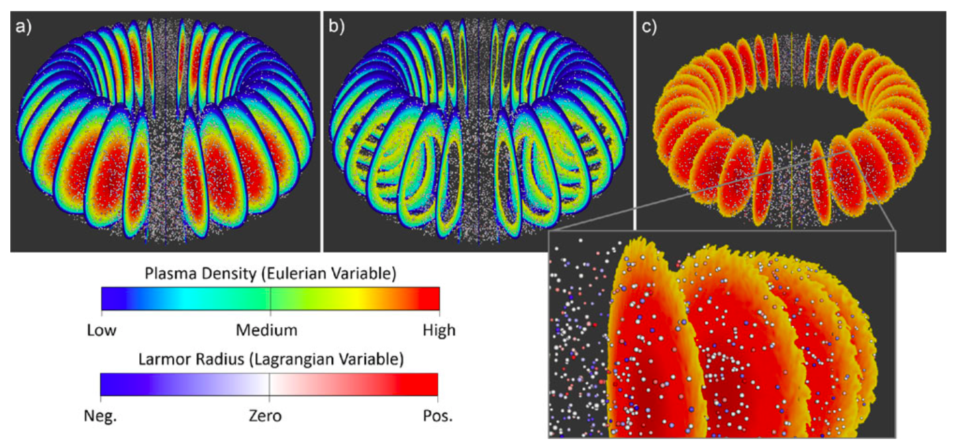
Fusion Dataset
Fig. a) No conditional query used. b) Conditionally querying unit cells that exhibit low plasma density. c) Conditionally querying unit cells that exhibit high plasma density.

Slide 12
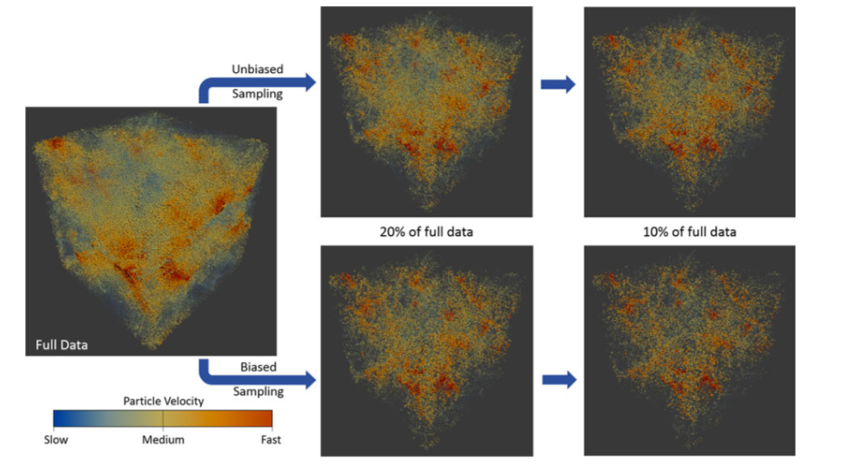
Cosmology Dataset
Fig. Comparing multi-resolution sampling schemes.

Slide 13
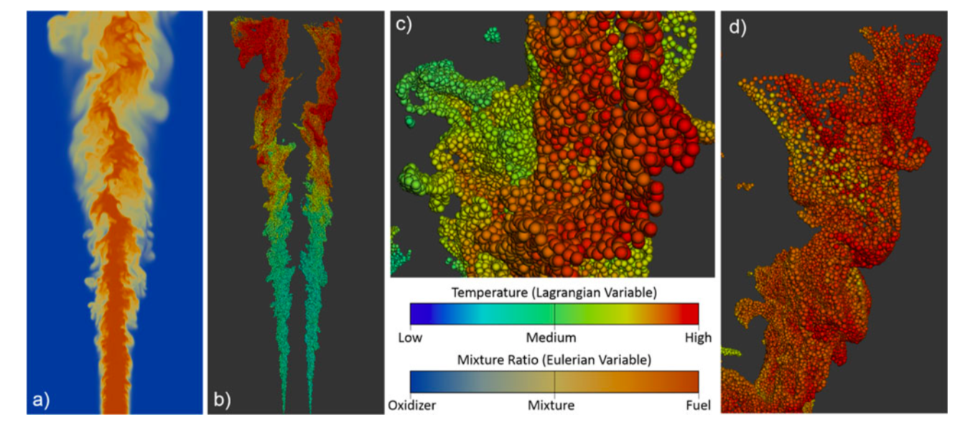
Combustion Dataset
Fig. a) 2D slice of Eulerian mixture ratio variable. b) Conditionally querying unit cells of specific mixture ratio. c/d) Zoomed views of particle structures in fig (b)

Slide 14
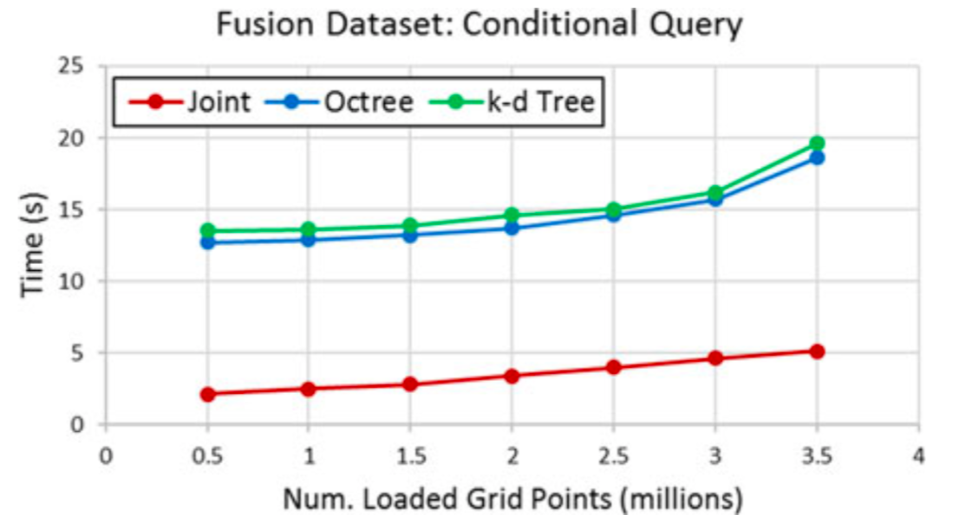
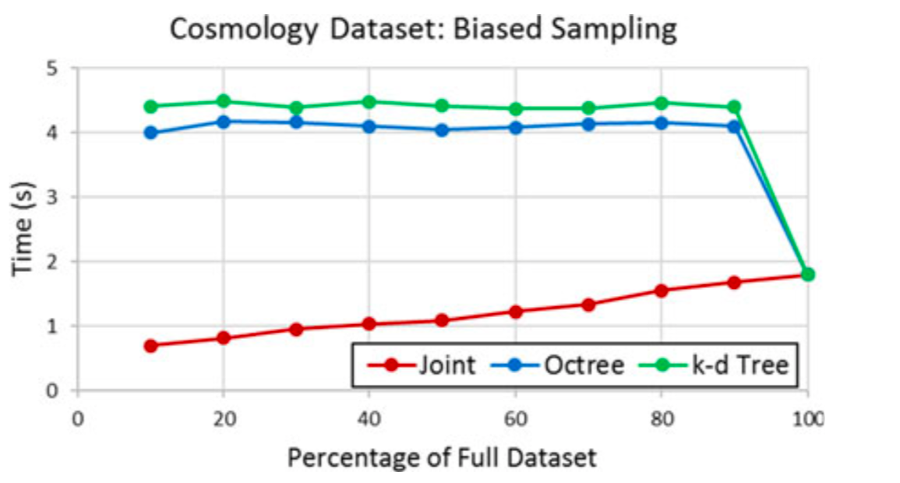
Fig. Timing results to generate conditional query on fusion dataset.
Fig. Timing results to generate biased multi-resolution sampling on cosmology dataset

Slide 15
Thank you

